Slide 1
Mobile Game Creative Design
Pertemuan 1

Slide 2
Let’s Start with Introduction.

Slide 3
Parlinggoman Hasibuan
kode dosen : D5555
email : hi@hasibuan.me
website : www.hasibuan.me
phone : +62 896 370 999 12
linkedin : linkedin.hasibuan.me
github : github.hasibuan.me
twitter : @linggom
a.k.a
GOMAN

Slide 4
Penilaian

Slide 5
Komposisi Nilai
50 % UAS
30 % UTS
20% TM

Slide 6
BUT

Slide 7
Mata kuliah ini merupakan perpaduan antara Game Design dan Entrepreneurship.

Slide 8


Slide 9
Let’s talk about TM
You need to create a Game
Based on 5-7 people
And collect to me on Week 6 and Week 13

Slide 10
Another thing about project (Group Project)
Game yang dibuat akan dipersentasikan 2 kali yaitu :
Pertemuan 6 :
Ide Bisnis
Bisnis Plan
Dan prototype
Pertemuan 13 :
Untuk pertemuan terakhir, game yang dibuat sudah harus di upload ke Market / Store ( Google Play Store, App Store, Nokia Store, BB Appworld, dll)

Slide 11

About
TM
QUESTIONS ?

Slide 12
Penilaian TM (Group)
Pertemuan 2
Pertemuan 6
Pertemuan 13
Persentasi IDE
Harus sudah ada ide
Sudah ada plan dan timeline dari dari pertemuan 2 s/d pertemuan 13
Persentasi dan Kumpul Dokumen
Ide Bisnis
Business Plan
Prototype
Persentasi dan Kumpul Dokumen
Upload game ke store
Submit code di Github
It’s okay if you have Bug

Slide 13
Milestones
Pertemuan 8
Presentasi progress (private)
Pertemuan 12
Apps sudah ada di store
Pertemuan 13
Presentasi Final
Pertemuan 2
ide, plan, dan target
Pertemuan 6
Presentasi prototipe and business plan
Pertemuan 3
Presentasi progress (private)
Pertemuan 10
Presentasi progress (private)

Slide 14

Mahasiswa yang bersangkutan tidak dapat menghadiri Binus Festival, maka nilai TM AKAN 0.

Slide 15
Komponen Penilaian (GROUP)
DO NOT BULLSHIT
PLEASE BE SMART
DO NOT ASK OTHER AND PAY THEM TO WORK ON YOUR PROJECT
I’LL GIVE YOU MORE POINT BASED ON YOUR PROGRESS
How do i monitor your progress ?

Slide 16


WHAT TOOLS WE WILL USED
https://github.com/LG01LEC

Slide 17
NOW INDIVIDUAL TM

Slide 18
CREATE A BLOG
Create with your domain (+1)
Use on of this blog (Wordpress, Ghost, Svbtle, or Medium)
What is the content ? Technology, Conference (+1), Participation on AISEC, BLUEJACK, YLI (+3), ACM, Meetup (+1), TopCoder.
AND POST IT EVERY WEEK
start from 27-09-2015
ended 27 - 02 - 2016
total 23 Post
And you need to write blog even it on vacation
please put your information like Info, CV and linkedin into your blog

Slide 19
Submit your post (url and title) to
https://LG01LEC.hasibuan.me

Slide 20


Slide 21
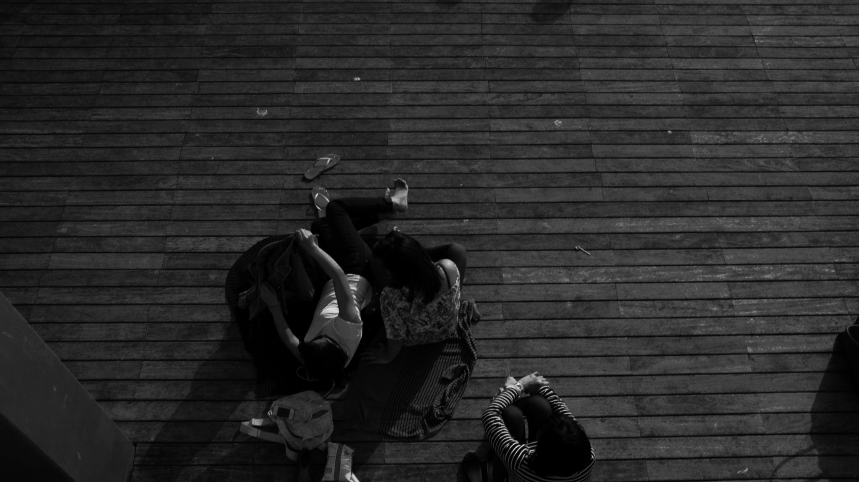
EXTRA SCORE
+50% - 100% score based on Group Project will be added to your UAS

Slide 22
About
TM
QUESTIONS ?

Slide 23
Now Let’s talk about Game
Pertemuan 1

Slide 24
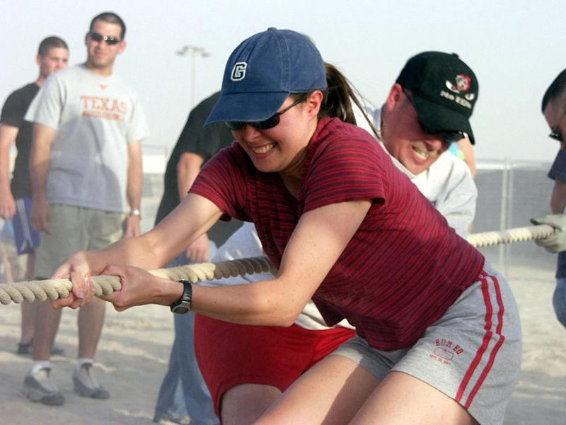
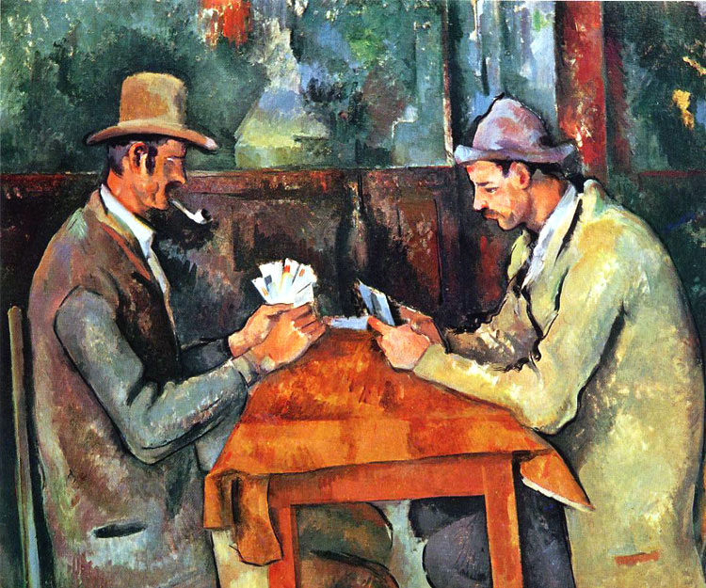
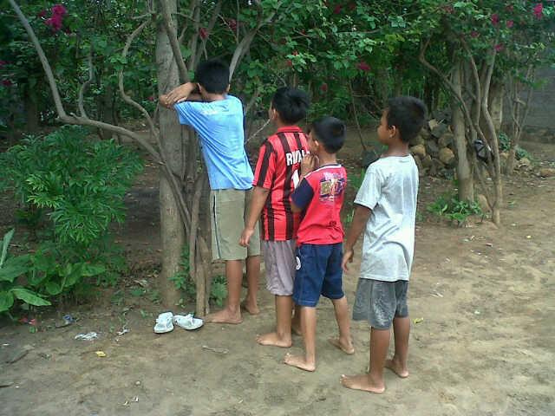
What is game ?
source : Wikipedia and Google

Slide 25
Are they smiling ?

Slide 26
What’s the difference between jokes ?

Slide 27
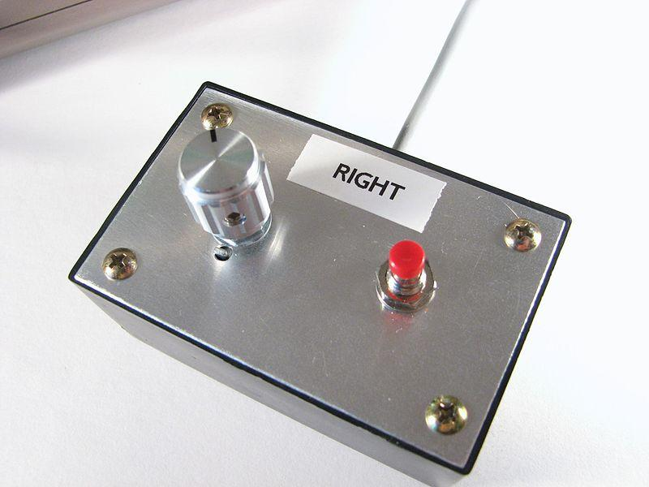
Wikipedia said about game and video game
A game is structured playing, usually undertaken for enjoyment and sometimes used as an educational tool
And playing is a range of voluntary, intrinsically motivated activities normally associated with recreational pleasure and enjoyment.
A video game is an electronic game that involves human interaction with a user interface to generate visual feedback on a video device such as a TV screen or computer monitor.
The first interactive video game
“Tennis for Two“ - 1958.
ps : my parents is not born yet

Slide 28
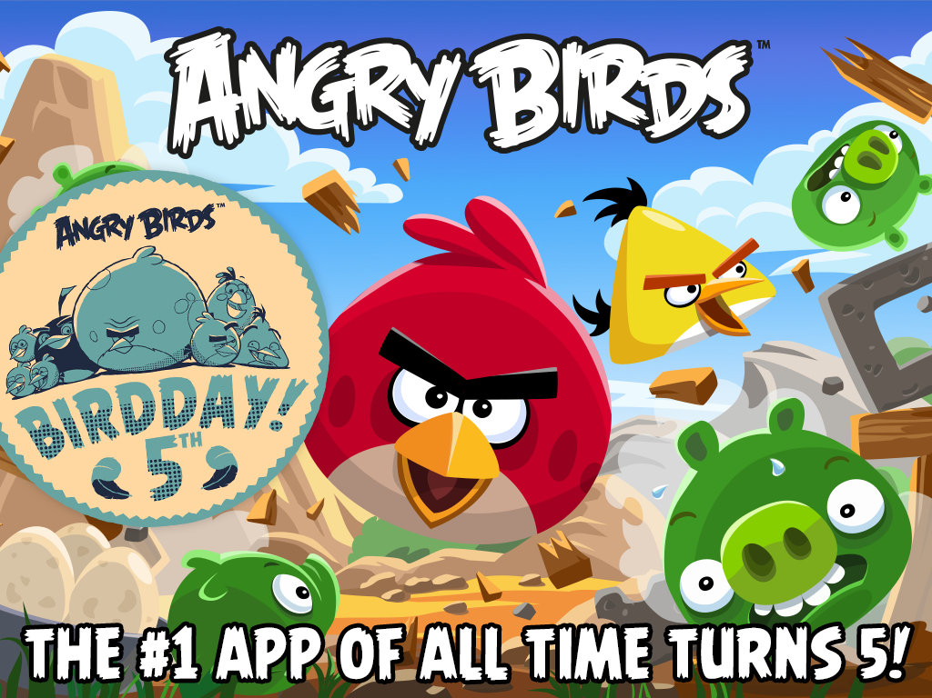
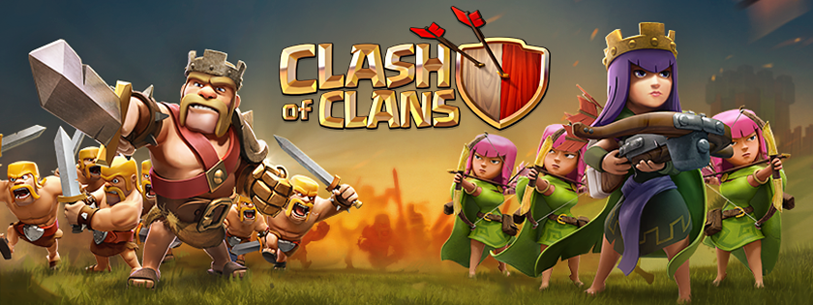

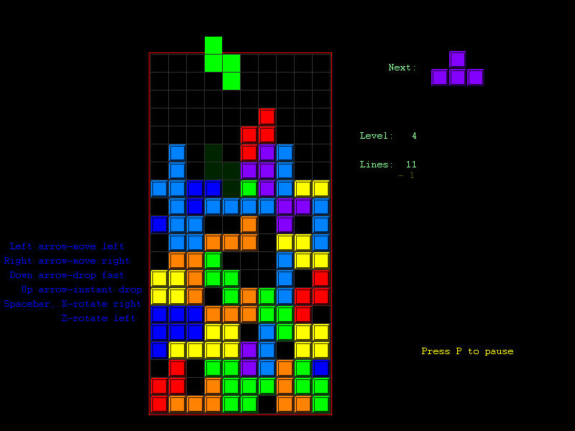
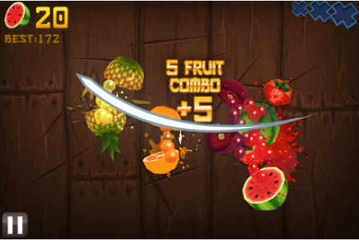
Let’s move to mobile game
source : Google Images

Slide 29


Let’s talk about mobile
APPLE FANBOY vs
ANDROID USER

Slide 30
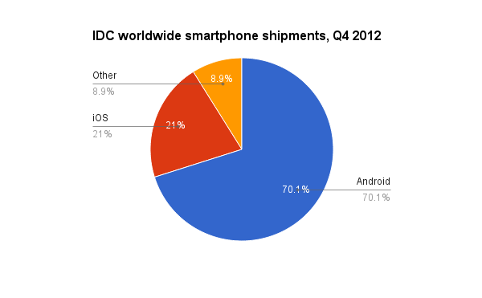
Ignore WP. It’s time IOS vs Android
Android (1)
iOS (0)
source : Time Magazine (http://techland.time.com/2013/04/16/ios-vs-android/)

Slide 31
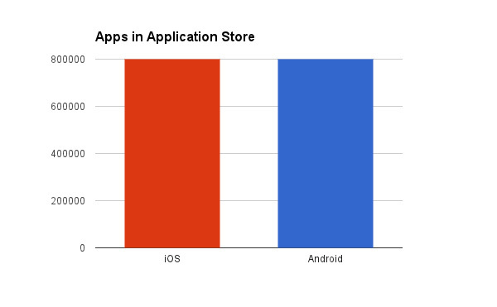
App in store ( it’s a tie)
Android (2)
iOS (1)
source : Time Magazine (http://techland.time.com/2013/04/16/ios-vs-android/)

Slide 32
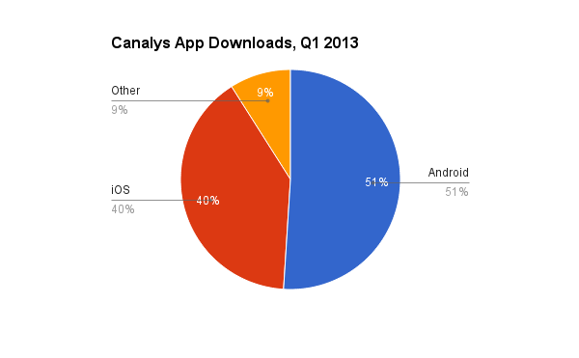
platform’s users are downloading the most apps
Android (3)
iOS (1)
source : Time Magazine (http://techland.time.com/2013/04/16/ios-vs-android/)

Slide 33
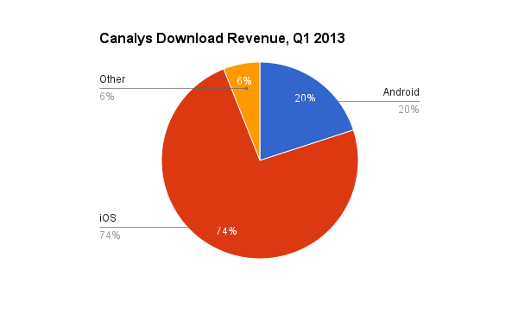
making money from app downloads
Android (3)
iOS (2)
source : Time Magazine (http://techland.time.com/2013/04/16/ios-vs-android/)

Slide 34
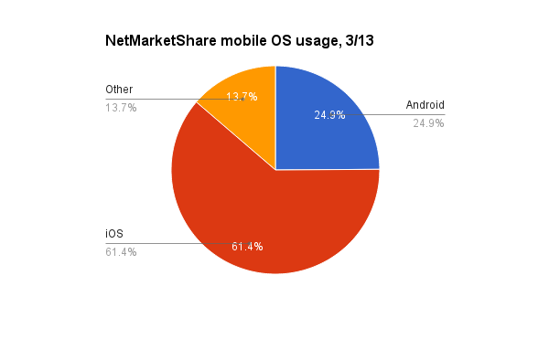
platform gets used most on the Internet
Android 3
iOS 3
source : Time Magazine (http://techland.time.com/2013/04/16/ios-vs-android/)

Slide 35
IT”S A TIE
No, it’s not a tie. Conclusion, the winner is :
Android if you’re talking about market share
iOS if you mean financial success

Slide 36
Another (MUST) reading
http://money.cnn.com/interactive/technology/iphone-android-comparison (Android Win)
https://id.techinasia.com/iphone-vs-android-mana-yang-lebih-bagus-untuk-gaming/ (IOS Win)
http://fieldguide.gizmodo.com/ios-vs-android-the-2015-edition-1700461435 (neutral)
http://features.en.softonic.com/whats-the-best-platform-for-games-android-ios-or-windows-phone (iOS win)
http://games.greggman.com/game/android-vs-ios-game-myths/ (MYTHOLOGY WHEN CHOOSE PLATFORM)

Slide 37
BUT WAIT. REMEMBER YOU ARE DEVELOPERS…..

Slide 38
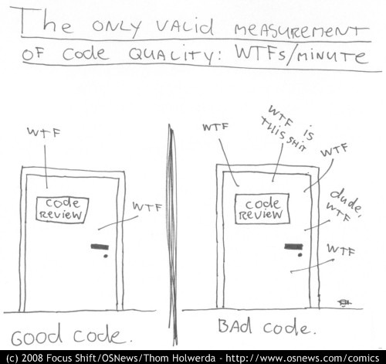

But. Number WTF from developer when develop game

Slide 39
Discussion ( Group )
pick 1 game, based on your experience, which one is the best game based on criteria like game play, graphics, multi player, or experience. Remember separate the OS. example :
For me, Clash Of Clans for Android is the winner of current game. Because i’m playing this game on church because it’s distract me when my priest is giving talk in front of anyone.

